Slide 1
Wifi Localization
2.5 Theoretic tests setup

Slide 2
Theoretic tests setup - overview
Generate grid
Generate path
For each point in path:
Calculate distance to grid nodes
Add error
Choose N closest points
Distances larger than radio range to be Infinity
Call MDS-MAP Algorithm
Compute error, write to file, display figure

Slide 3
Theoretic tests setup - parameters
GridPositionJitter = 0.2; (Random grid)
PathNumberOfSplits = 5; (2^N+1 path points)
NumberOfPointsToFilter = 10;
RadioRange = 0.2;
ErrorPercentageOfRange = 0.1;

Slide 4
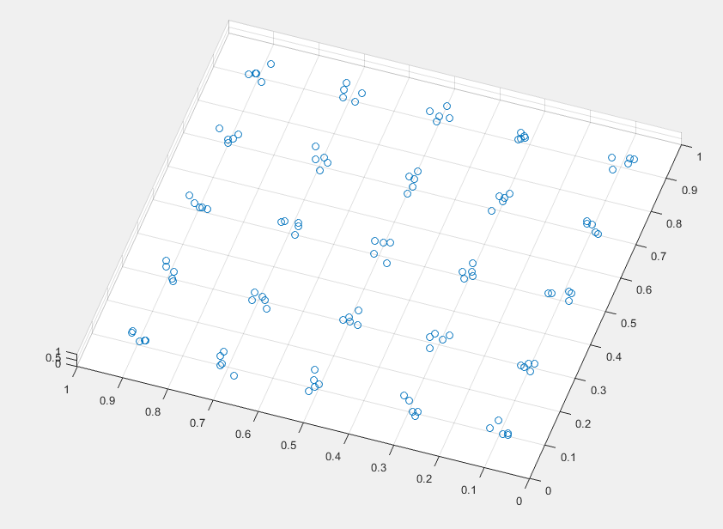
1. Generating grid

Slide 5
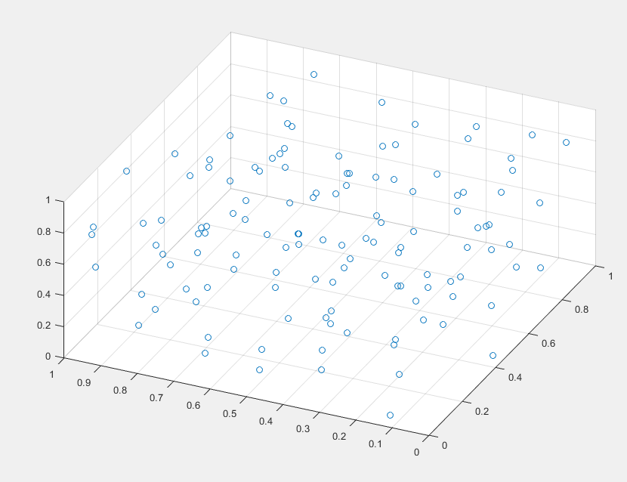
1. Generating grid – Random

Slide 6
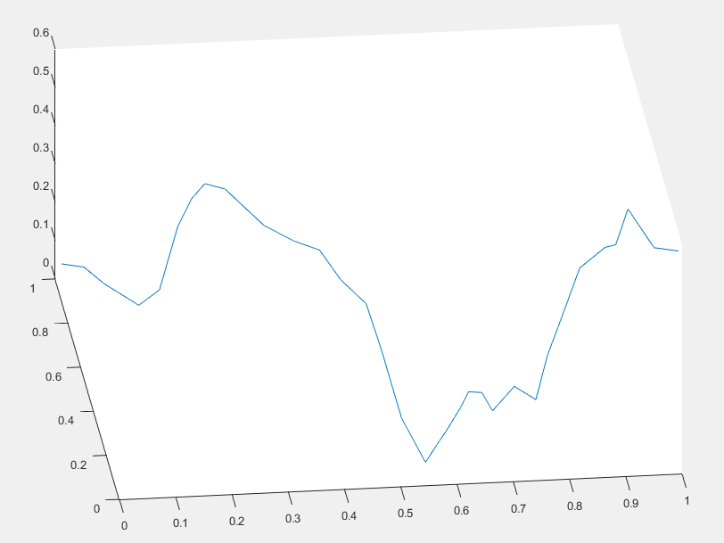
2. Generating path

Slide 7
3. For each point in path
Calculate distance to grid nodes
Add error
Choose N closest points
Distances larger than radio range to be Infinity
Call MDS-MAP Algorithm

Slide 8
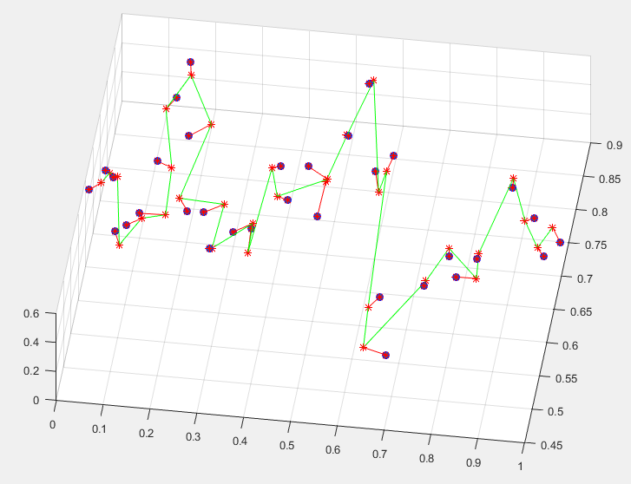
4. Compute error, write to file, display figure

Slide 9
Test results for Error variation - Parameters
GridPositionJitter 0.200000
PathNumberOfSplits 5.000000
NumberOfPointsToFilter 10.000000
RadioRange 0.500000
ErrorPercentageOfRange [0.010000 – 0.290000]

Slide 10
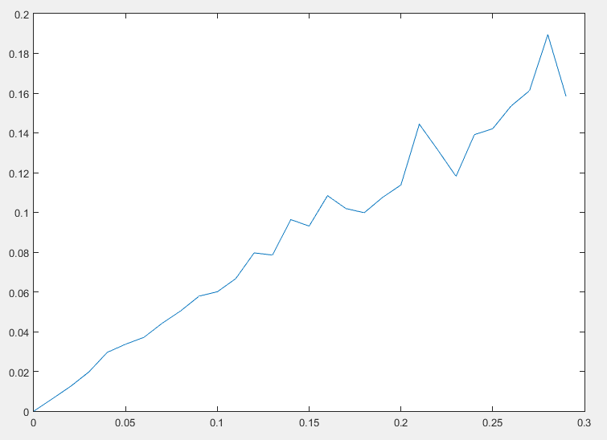
Test results for Error variation - Results

Slide 11
Test results for Range variation - Parameters
GridPositionJitter 0.200000
PathNumberOfSplits 5.000000
NumberOfPointsToFilter 10.000000
ErrorPercentageOfRange 0.100000
RadioRange [0.020000 – 1.000000]

Slide 12
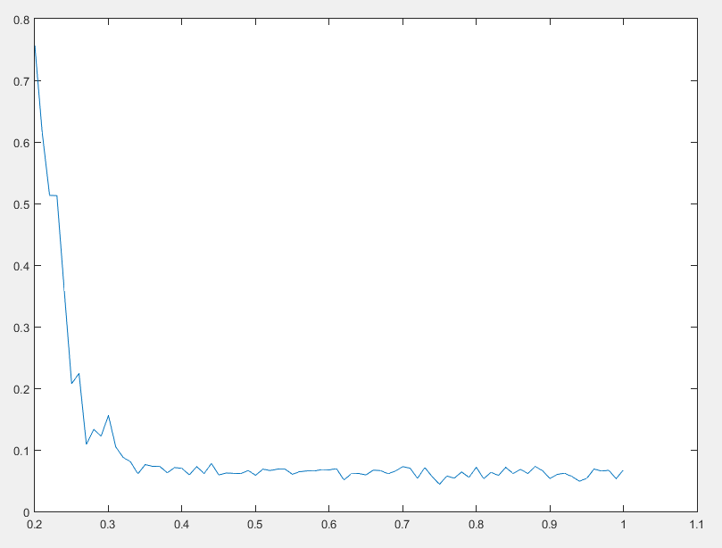
Test results for Range variation - Results

